Slide 1

Chapter 9: Classical Macroeconomics and the Self-Regulating Economy
© 2014 Cengage Learning. All Rights Reserved. May not be copied, scanned, or duplicated, in whole or in part, except for use as permitted in a license distributed with certain product , service, or otherwise on password-protected website for classroom use

Slide 2

In This Lecture…..
  Say’s Law
  Classical Economists on Markets, Wages, and Prices
  Three States of the Economy
  The Institutional and Physical Production Possibilities Frontiers
  The Self-Regulating Economy
  Business Cycle Economics and Economic Growth Macroeconomics
To select a topic, click on its link above
© 2014 Cengage Learning. All Rights Reserved. May not be copied, scanned, or duplicated, in whole or in part, except for use as permitted in a license distributed with certain product , service, or otherwise on password-protected website for classroom use

Slide 3

Classical Economics
The term classical economics is often used to refer to an era in the history of economic thought that stretched from about 1750 to the early 1900s. Although classical economists lived and wrote many years ago, their ideas are often employed by some modern-day economists.
Click to return to “In this Lesson”
© 2014 Cengage Learning. All Rights Reserved. May not be copied, scanned, or duplicated, in whole or in part, except for use as permitted in a license distributed with certain product , service, or otherwise on password-protected website for classroom use

Slide 4
Say’s Law
Supply creates its own demand. Production creates demand sufficient to purchase all goods and services produced.
Say’s law implies that there cannot be either
(1) a general overproduction of goods (where supply in the economy is greater than demand in the economy) or
(2) a general underproduction of goods (where demand in the economy is greater than supply in the economy).
Click to return to “In this Lesson”
© 2014 Cengage Learning. All Rights Reserved. May not be copied, scanned, or duplicated, in whole or in part, except for use as permitted in a license distributed with certain product , service, or otherwise on password-protected website for classroom use

Slide 5
Say’s Law in a barter Economy
This law is most easily understood in terms of a barter economy.
Consider a person baking bread in a barter economy; the baker is a supplier of bread. According to Say, the baker works at his trade because he plans to demand other goods.
As he is baking bread, the baker is thinking of the goods and services he will obtain in exchange for it. Thus, his act of supplying bread is linked to his demand for other goods. Supply creates its own demand.
If supplying some goods leads to a simultaneous demand for other goods, then Say’s law implies that there cannot be either (1) a general overproduction of goods (where supply in the economy is greater than demand) or (2) a general underproduction of goods (where demand in the economy is greater than supply).
Click to return to “In this Lesson”
© 2014 Cengage Learning. All Rights Reserved. May not be copied, scanned, or duplicated, in whole or in part, except for use as permitted in a license distributed with certain product , service, or otherwise on password-protected website for classroom use

Slide 6
Say’s Law in a Money Economy
On the other hand, if the baker is baking bread in a money economy, does Say’s law hold?
Over a period of time, the baker earns an income as a result of supplying bread, but what does he do with the income? One use of the money is to buy goods and services.
However, his demand for goods and services does not necessarily match the income that he generates by supplying bread. The baker may spend less than his full income because he saves.
So we might think that Say’s law does not hold in a money economy because the act of supplying goods and services—thus earning income—need not create an equal amount of demand.
Click to return to “In this Lesson”
© 2014 Cengage Learning. All Rights Reserved. May not be copied, scanned, or duplicated, in whole or in part, except for use as permitted in a license distributed with certain product , service, or otherwise on password-protected website for classroom use

Slide 7
Say’s Law in a Money Economy
If consumption drops and saving rises, economic forces are at work producing an equal increase in investment.
C↓ S↑→ I↑
Click to return to “In this Lesson”
© 2014 Cengage Learning. All Rights Reserved. May not be copied, scanned, or duplicated, in whole or in part, except for use as permitted in a license distributed with certain product , service, or otherwise on password-protected website for classroom use

Slide 8
Savings, Investment and the Loanable Funds market
Savings and investment are linked through the loanable funds market.
Click the graph below for a tutorial on this subject.
Click to return to “In this Lesson”
© 2014 Cengage Learning. All Rights Reserved. May not be copied, scanned, or duplicated, in whole or in part, except for use as permitted in a license distributed with certain product , service, or otherwise on password-protected website for classroom use

Slide 9
The Classical View of the Credit
Market
In classical theory, the interest rate is flexible and adjusts so that saving equals investment.
If saving increases and the saving curve shifts rightward the increase in saving eventually puts pressure on the interest rate and moves it downward.
A new equilibrium is established where once again the amount households save equals the amount firms invest.
Click to return to “In this Lesson”
© 2014 Cengage Learning. All Rights Reserved. May not be copied, scanned, or duplicated, in whole or in part, except for use as permitted in a license distributed with certain product , service, or otherwise on password-protected website for classroom use

Slide 10
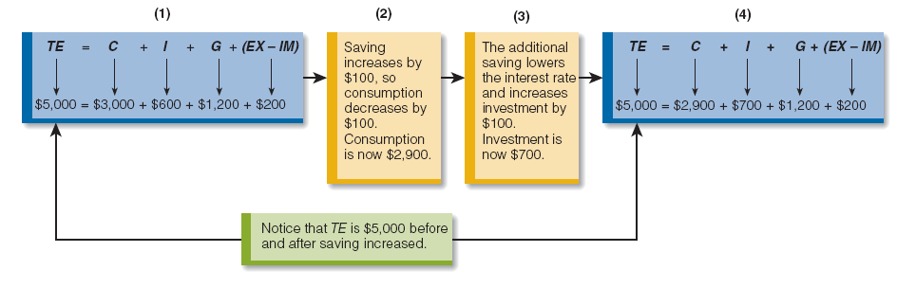
Say’s Law in a Money Economy
Click to return to “In this Lesson”
© 2014 Cengage Learning. All Rights Reserved. May not be copied, scanned, or duplicated, in whole or in part, except for use as permitted in a license distributed with certain product , service, or otherwise on password-protected website for classroom use

Slide 11
Self-Test
Explain Say’s law in terms of a barter economy.
Say’s law states that supply creates its own demand. In a barter economy, Jones supplies good X only so that she can use it to demand some other good (e.g., good Y). The act of supplying is motivated by the desire to demand. Supply and demand are opposite sides of the same coin.
Click to return to “In this Lesson”
© 2014 Cengage Learning. All Rights Reserved. May not be copied, scanned, or duplicated, in whole or in part, except for use as permitted in a license distributed with certain product , service, or otherwise on password-protected website for classroom use

Slide 12
Self-Test
2. According to classical economists, if saving rises and consumption spending falls, will total spending in the economy decrease? Explain your answer.
No, total spending will not decrease. For classical economists, an increase in saving (reflected in a decrease in consumption) will lower the interest rate and stimulate investment spending. So one spending component (consumption) goes down, and another spending component (investment) goes up. Moreover, according to classical economists, the decrease in one spending component will be completely offset by an increase in another spending component so that overall spending does not change.
Click to return to “In this Lesson”
© 2014 Cengage Learning. All Rights Reserved. May not be copied, scanned, or duplicated, in whole or in part, except for use as permitted in a license distributed with certain product , service, or otherwise on password-protected website for classroom use

Slide 13
Self-Test
3. What is the classical position on prices and wages?
Prices and wages are flexible; they move up and down in response to market conditions.
Click to return to “In this Lesson”
© 2014 Cengage Learning. All Rights Reserved. May not be copied, scanned, or duplicated, in whole or in part, except for use as permitted in a license distributed with certain product , service, or otherwise on password-protected website for classroom use

Slide 14
Three States of the Economy
Real GDP is less than Natural Real GDP (recessionary gap).
Real GDP is greater than Natural Real GDP (inflationary gap).
Real GDP is equal to Natural Real GDP (long-run equilibrium).
Click to return to “In this Lesson”
© 2014 Cengage Learning. All Rights Reserved. May not be copied, scanned, or duplicated, in whole or in part, except for use as permitted in a license distributed with certain product , service, or otherwise on password-protected website for classroom use

Slide 15
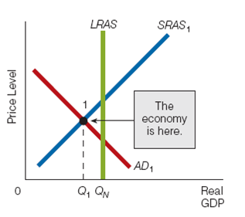
Recessionary (Contractionary) Gap
The condition where the Real GDP the economy is producing is less than the
Natural Real GDP and the unemployment rate is greater than the natural unemployment rate.
Click to return to “In this Lesson”
© 2014 Cengage Learning. All Rights Reserved. May not be copied, scanned, or duplicated, in whole or in part, except for use as permitted in a license distributed with certain product , service, or otherwise on password-protected website for classroom use

Slide 16
Recessionary (Contractionary) Gap
The economy is currently in short-run equilibrium at a Real GDP level of Q₁.
Q_{N} is Natural Real GDP or the potential output of the economy.
Notice that Q₁< Q_{N}. When this condition (Q₁< Q_{N}) exists, the economy is said to be in a recessionary gap.
© 2014 Cengage Learning. All Rights Reserved. May not be copied, scanned, or duplicated, in whole or in part, except for use as permitted in a license distributed with certain product , service, or otherwise on password-protected website for classroom use
Click to return to “In this Lesson”

Slide 17
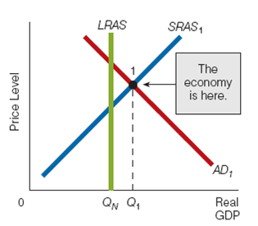
Inflationary (Expansionary) Gap
The condition where the Real GDP the economy is producing is greater than the Natural Real GDP and the unemployment rate is less than the natural unemployment rate.
Click to return to “In this Lesson”
© 2014 Cengage Learning. All Rights Reserved. May not be copied, scanned, or duplicated, in whole or in part, except for use as permitted in a license distributed with certain product , service, or otherwise on password-protected website for classroom use

Slide 18
Inflationary (Expansionary) Gap
The economy is currently in short-run equilibrium at a Real GDP level of Q₁.
Q_{N} is Natural Real GDP or the potential output of the economy.
Notice that Q₁>Q_{N}. When this condition (Q₁>Q_{N}) exists, the economy is said to be in an inflationary gap.
Click to return to “In this Lesson”
© 2014 Cengage Learning. All Rights Reserved. May not be copied, scanned, or duplicated, in whole or in part, except for use as permitted in a license distributed with certain product , service, or otherwise on password-protected website for classroom use

Slide 19
Economy and Labor Market
Click to return to “In this Lesson”
© 2014 Cengage Learning. All Rights Reserved. May not be copied, scanned, or duplicated, in whole or in part, except for use as permitted in a license distributed with certain product , service, or otherwise on password-protected website for classroom use

Slide 20
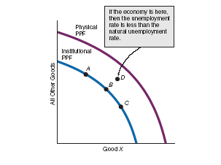
Physical and Institutional PPF’s
The physical PPF illustrates different combinations of goods the economy can produce given the physical constraints of finite resources and (2) the current state of technology.
The institutional PPF illustrates different combinations of goods the economy can produce given the physical constraints (1) finite resources, (2) the current state of technology, and (3) any institutional constraints.
Click to return to “In this Lesson”
© 2014 Cengage Learning. All Rights Reserved. May not be copied, scanned, or duplicated, in whole or in part, except for use as permitted in a license distributed with certain product , service, or otherwise on password-protected website for classroom use

Slide 21
Physical and Institutional PPF’s
The economy is at the natural unemployment rate if it is located on its institutional PPF, such as at points A, B, or C.
An economy can never operate beyond its physical PPF, but it is possible for it to operate beyond its institutional PPF because institutional constraints are not always equally effective.
If the economy does operate beyond its institutional PPF (i.e. minimum wage), such as at point D, then the unemployment rate in the economy is lower than the natural unemployment rate.
Click to return to “In this Lesson”
© 2014 Cengage Learning. All Rights Reserved. May not be copied, scanned, or duplicated, in whole or in part, except for use as permitted in a license distributed with certain product , service, or otherwise on password-protected website for classroom use

Slide 22
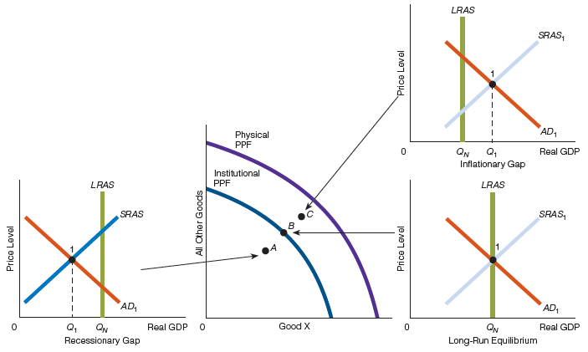
Three states of the Economy
Click to return to “In this Lesson”
© 2014 Cengage Learning. All Rights Reserved. May not be copied, scanned, or duplicated, in whole or in part, except for use as permitted in a license distributed with certain product , service, or otherwise on password-protected website for classroom use

Slide 23
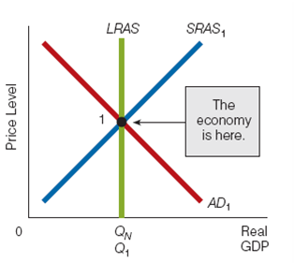
Long-run Equilibrium
The condition where the Real GDP the economy is producing is equal to the Natural Real GDP and the unemployment rate is equal to the natural unemployment rate.
Click to return to “In this Lesson”
© 2014 Cengage Learning. All Rights Reserved. May not be copied, scanned, or duplicated, in whole or in part, except for use as permitted in a license distributed with certain product , service, or otherwise on password-protected website for classroom use

Slide 24
Long-run Equilibrium
The economy is currently operating at a Real GDP level of Q₁,which is equal to Q_{N}.
In other words, the economy is producing its Natural Real GDP or potential output.
When this condition (Q₁= Q_{N}) exists, the economy is said to be in long-run equilibrium.
Click to return to “In this Lesson”
© 2014 Cengage Learning. All Rights Reserved. May not be copied, scanned, or duplicated, in whole or in part, except for use as permitted in a license distributed with certain product , service, or otherwise on password-protected website for classroom use

Slide 25
Self-Test
What is a recessionary gap? an inflationary gap?
A recessionary gap exists if the economy is producing a Real GDP level that is less than Natural Real GDP. An inflationary gap exists if the economy is producing a Real GDP level that is more than Natural Real GDP.
Click to return to “In this Lesson”
© 2014 Cengage Learning. All Rights Reserved. May not be copied, scanned, or duplicated, in whole or in part, except for use as permitted in a license distributed with certain product , service, or otherwise on password-protected website for classroom use

Slide 26
Self-Test
2. What is the state of the labor market when the economy is in a recessionary gap? in an inflationary gap?
When the economy is in a recessionary gap, the labor market has a surplus. When the economy is in an inflationary gap, there is a shortage in the labor market.
Click to return to “In this Lesson”
© 2014 Cengage Learning. All Rights Reserved. May not be copied, scanned, or duplicated, in whole or in part, except for use as permitted in a license distributed with certain product , service, or otherwise on password-protected website for classroom use

Slide 27
Self-Test
3. If the economy is in an inflationary gap, locate its position in terms of the two PPFs discussed in this section.
The economy is somewhere above the institutional PPF and below the physical PPF.
Click to return to “In this Lesson”
© 2014 Cengage Learning. All Rights Reserved. May not be copied, scanned, or duplicated, in whole or in part, except for use as permitted in a license distributed with certain product , service, or otherwise on password-protected website for classroom use

Slide 28
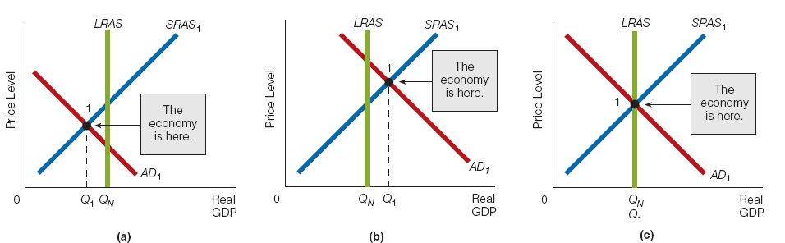
Self Regulating Economy
Closing the Recessionary (Contractionary) Gap
Click the graph below for a tutorial on this subject.
Click to return to “In this Lesson”
© 2014 Cengage Learning. All Rights Reserved. May not be copied, scanned, or duplicated, in whole or in part, except for use as permitted in a license distributed with certain product , service, or otherwise on password-protected website for classroom use

Slide 29
Self Regulating Economy
Closing the Recessionary (Contractionary) Gap
The economy is at P₁ and Real GDP of $9 trillion.
Because Real GDP is less than Natural Real GDP ($10 trillion), the economy is in a recessionary gap and the unemployment rate is higher than the natural unemployment rate.
Click to return to “In this Lesson”
© 2014 Cengage Learning. All Rights Reserved. May not be copied, scanned, or duplicated, in whole or in part, except for use as permitted in a license distributed with certain product , service, or otherwise on password-protected website for classroom use

Slide 30
Self Regulating Economy
Closing the Recessionary (Contractionary) Gap
Wage rates fall, and the short-run aggregate supply curve shifts from SRAS₁ to SRAS₂.
As the price level falls, the real balance, interest rate, and international trade effects increase the quantity demanded of Real GDP.
Ultimately, the economy moves into long-run equilibrium at point 2.
Click to return to “In this Lesson”
© 2014 Cengage Learning. All Rights Reserved. May not be copied, scanned, or duplicated, in whole or in part, except for use as permitted in a license distributed with certain product , service, or otherwise on password-protected website for classroom use

Slide 31
Self Regulating Economy
Closing the Inflationary (Expansionary) Gap
Click the graph below for a tutorial on this subject.
Click to return to “In this Lesson”
© 2014 Cengage Learning. All Rights Reserved. May not be copied, scanned, or duplicated, in whole or in part, except for use as permitted in a license distributed with certain product , service, or otherwise on password-protected website for classroom use

Slide 32
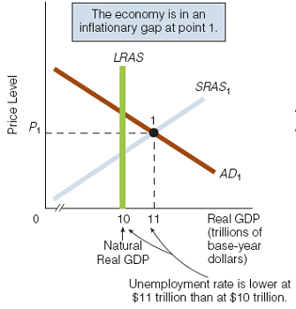
Self Regulating Economy
Closing the Inflationary (Expansionary) Gap
The economy is at P₁ and Real GDP of $11 trillion.
Because Real GDP is greater than Natural Real GDP ($10 trillion), the economy is in an inflationary gap and the unemployment rate is lower than the natural unemployment rate.
Click to return to “In this Lesson”
© 2014 Cengage Learning. All Rights Reserved. May not be copied, scanned, or duplicated, in whole or in part, except for use as permitted in a license distributed with certain product , service, or otherwise on password-protected website for classroom use

Slide 33
Self Regulating Economy
Closing the Inflationary (Expansionary) Gap
Wage rates rise, and the short-run aggregate supply curve shifts from SRAS₁ to SRAS₂.
As the price level rises, the real balance, interest rate, and international trade effects decrease the quantity demanded of Real GDP.
Ultimately, the economy moves into long-run equilibrium at point 2.
Click to return to “In this Lesson”
© 2014 Cengage Learning. All Rights Reserved. May not be copied, scanned, or duplicated, in whole or in part, except for use as permitted in a license distributed with certain product , service, or otherwise on password-protected website for classroom use

Slide 34
Self-Regulating Economy
A Summary
Click to return to “In this Lesson”
© 2014 Cengage Learning. All Rights Reserved. May not be copied, scanned, or duplicated, in whole or in part, except for use as permitted in a license distributed with certain product , service, or otherwise on password-protected website for classroom use

Slide 35

Policy Implication
Laissez-faire
Classical, new classical, and monetarist economists believe that the economy is self-regulating. For these economists, full employment is the norm: The economy always moves back to Natural Real GDP.
Laissez-faire
A public policy of not interfering
with market activities in the economy.
Click to return to “In this Lesson”
© 2014 Cengage Learning. All Rights Reserved. May not be copied, scanned, or duplicated, in whole or in part, except for use as permitted in a license distributed with certain product , service, or otherwise on password-protected website for classroom use

Slide 36
Self Regulating Economy
From Short-run to Long-run
Click to return to “In this Lesson”
© 2014 Cengage Learning. All Rights Reserved. May not be copied, scanned, or duplicated, in whole or in part, except for use as permitted in a license distributed with certain product , service, or otherwise on password-protected website for classroom use

Slide 37
Recap of Classical Macroeconomics
1. Say’s law holds.
2. Interest rates change such that savings equals investment.
3. The economy is self-regulating, making full employment and an economy producing Natural Real GDP the norm.
4. Prices and wages are flexible. In other words, if the economy is in a recessionary gap, wages fall and the economy soon moves itself toward producing Natural Real GDP (at a lower price level than in the recessionary gap). If the economy is in an inflationary gap, wages rise and the economy soon moves itself toward producing Natural Real GDP (at higher price level than in the inflationary gap).
5. Because the economy is self-regulating, laissez-faire is the policy prescription.
Click to return to “In this Lesson”
© 2014 Cengage Learning. All Rights Reserved. May not be copied, scanned, or duplicated, in whole or in part, except for use as permitted in a license distributed with certain product , service, or otherwise on password-protected website for classroom use

Slide 38
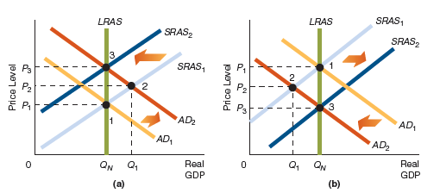
Business Cycle Macroeconomics
Business-cycle macroeconomics can be described as changes in Real GDP with respect to a fixed LRAS curve,
Click to return to “In this Lesson”
© 2014 Cengage Learning. All Rights Reserved. May not be copied, scanned, or duplicated, in whole or in part, except for use as permitted in a license distributed with certain product , service, or otherwise on password-protected website for classroom use

Slide 39
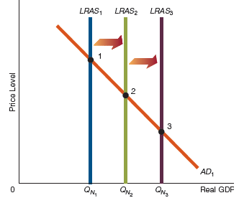
Economic-Growth
Macroeconomics
Economic-growth macroeconomics deals with rightward shifts in the long-run aggregate supply curve (LRAS).
Click to return to “In this Lesson”
© 2014 Cengage Learning. All Rights Reserved. May not be copied, scanned, or duplicated, in whole or in part, except for use as permitted in a license distributed with certain product , service, or otherwise on password-protected website for classroom use

Slide 40
Self-Test
If the economy is self-regulating, what happens if it is in a recessionary gap?
In a recessionary gap, the existing unemployment rate is greater than the natural unemployment rate, implying that unemployment is relatively high. As wage contracts expire, business firms will negotiate new ones that pay workers lower wage rates. As a result, the SRAS curve shifts rightward. As this happens, the price level begins to fall. The economy moves down the AD curve—eventually to the point where it intersects the LRAS curve. At this point, the economy is in long-run equilibrium.
Click to return to “In this Lesson”
© 2014 Cengage Learning. All Rights Reserved. May not be copied, scanned, or duplicated, in whole or in part, except for use as permitted in a license distributed with certain product , service, or otherwise on password-protected website for classroom use

Slide 41
Self-Test
2. If the economy is self-regulating, what happens if it is in an inflationary gap?
In an inflationary gap, the existing unemployment rate is less than the natural unemployment rate, implying that unemployment is relatively low. As wage contracts expire, business firms will negotiate contracts that pay workers higher wage rates. As a result, the SRAS curve shifts leftward. As this happens, the price level begins to rise. The economy moves up the AD curve—eventually to the point where it intersects the LRAS curve. At this point, the economy is in long-run equilibrium.
Click to return to “In this Lesson”
© 2014 Cengage Learning. All Rights Reserved. May not be copied, scanned, or duplicated, in whole or in part, except for use as permitted in a license distributed with certain product , service, or otherwise on password-protected website for classroom use

Slide 42
Self-Test
3. If the economy is self-regulating, how do changes in aggregate demand affect the economy in the long run?
Any changes in aggregate demand will affect—in the long run—only the price level, not the Real GDP level or the unemployment rate. Stated differently, changes in AD in an economy will have no long-run effect on the Real GDP that a country produces or on its unemployment rate; changes in AD will change only the price level in the long run.
Click to return to “In this Lesson”
© 2014 Cengage Learning. All Rights Reserved. May not be copied, scanned, or duplicated, in whole or in part, except for use as permitted in a license distributed with certain product , service, or otherwise on password-protected website for classroom use

Slide 43

Wall Street Journal
The Wall Street Journal is a is a rich source of information which provides real life examples of micro- and macro economic activities. Check today’s issue to see the most current news.
http://www.wsj.com
Click to return to “In this Lesson”
© 2014 Cengage Learning. All Rights Reserved. May not be copied, scanned, or duplicated, in whole or in part, except for use as permitted in a license distributed with certain product , service, or otherwise on password-protected website for classroom use

